Slide 1
ADVERSARIAL ATTACKS & DEFENCES ON PHISHING DETECTION MODELS
Prepared by : Archana Sreekumar (AM.EN.P2CSN18005)
Mentored by : Dr Krishnashree Achuthan
Collaborator : Mr Gilad Gressel, Georgia Tech, USA

Slide 2
OVERVIEW
What is phishing?
Adversarial attack on ML model
Problem statement
Literature survey
  Fast gradient sign method
  Why do adversarial attacks exist?
  Adversarial attacks and defences
  Adversarial examples for malware detection
  Adversarial attacks using reverse engineering
  Adversarial sampling attacks against phishing detection
Proposed architecture
Roadmap until next review
Conclusion

Slide 3

What is Phishing?
“Phishing is the act of tricking people into
entering their sensitive information by
disguising oneself as a trustworthy entity”
Source: https://whatismyipaddress.com/phishing

Slide 4
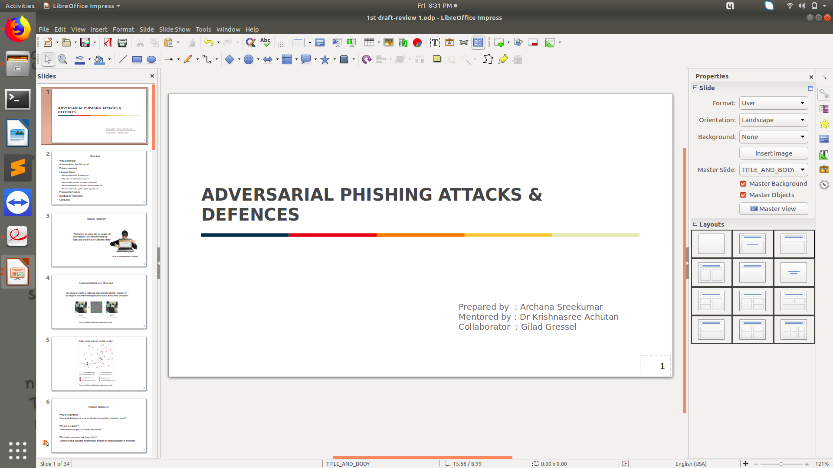
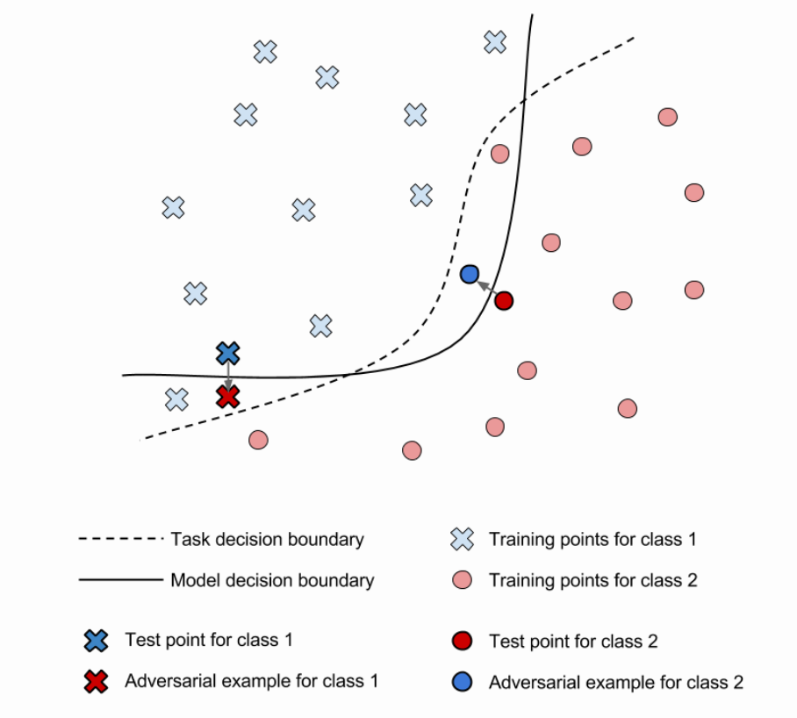
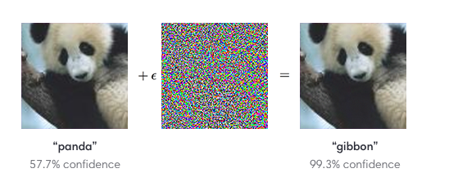
Adversarial Attacks on ML Model
Impact of adversary on decision making of model
“An adversary crafts a malicious input sample with the intention of causing the machine learning model to make an incorrect prediction”
Source: Explaining and Harnessing Adversarial Examples, Goodfellow et al.[6]
Source: https://openai.com/blog/adversarial-example-research/

Slide 5
Problem Statement
“To learn whether phishing detection models are vulnerable to adversarial
attacks and to defend the model against such adversarial attacks.”
Carefully crafted adversarial examples could evade phishing detection models.
Millions of user accounts could be compromised through the misclassification of phishing detection models under adversarial attack.

Slide 6
Literature Survey

Slide 7
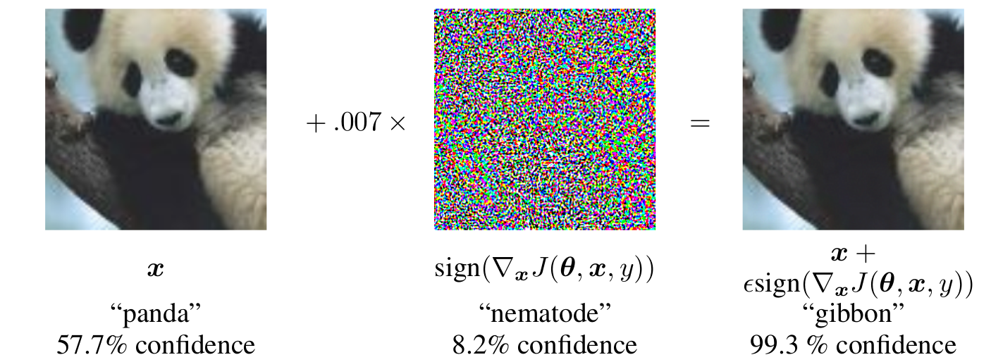
Fast Gradient Sign Method(FGSM)
J
Cost function gradient
Taking sign
€ * sign
Source: Explaining and Harnessing Adversarial Examples, Goodfellow et al.[6]
True label (+)
x ± € * sign
y
Target label (-)
x'
Goodfellow, Ian J., Jonathon Shlens, and Christian Szegedy. "Explaining and harnessing adversarial examples."
arXiv preprint arXiv:1412.6572 (2014).# citations – 2855, Google h5 index – 150

Slide 8
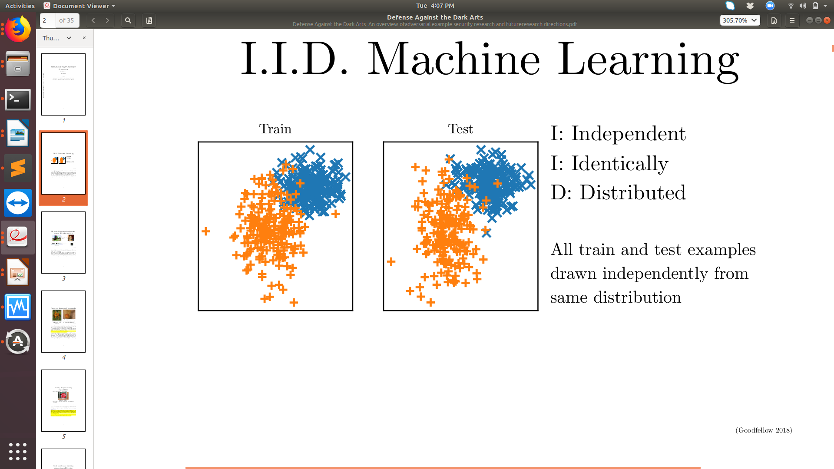
Why do Adversarial Attacks Exist?
Machine learning is done with IID (Independent Identically Distributed) assumption.
  All examples in training and test set generated independently from each other.
  All are drawn from same data distribution.
Figure shows several training examples & test examples.
Goodfellow, Ian. "Defense Against the Dark Arts: An overview of adversarial example security research and future research directions." IEEE Security and Privacy. arXiv preprint arXiv:1806.04169 (2018). #citaions – 10, Google h5 index – 32.

Slide 9
Why do Adversarial Attacks Exist?
Both drawn independently from same distribution.
Data at test time is very similar to data at training time.
Imperceptible changes to IID test samples can lead to misclassification.
Modification of test input can cause two IID violations
  Test data not drawn from same distribution as training data.
  Test examples not necessarily drawn independently from each other.
Goodfellow, Ian. "Defense Against the Dark Arts: An overview of adversarial example security research and future research directions." IEEE Security and Privacy. arXiv preprint arXiv:1806.04169 (2018). #citaions – 10, Google h5 index – 32.

Slide 10
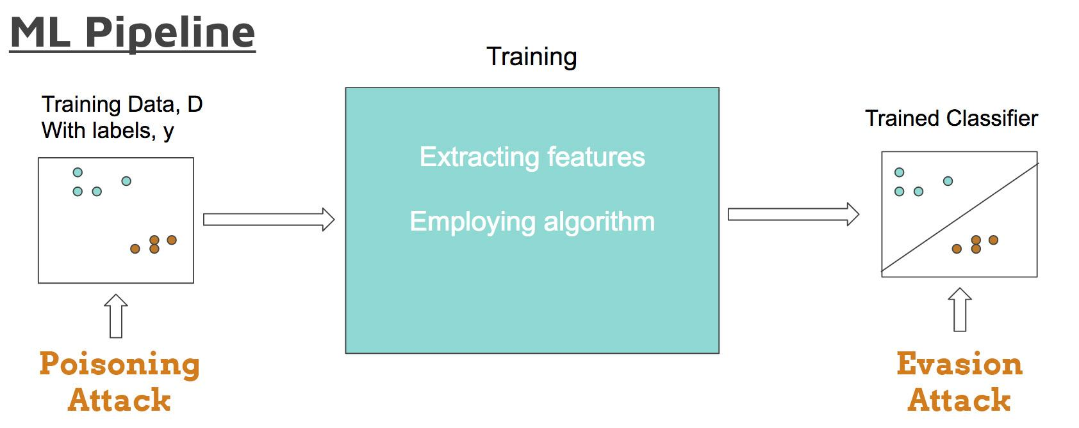
Adversarial Attacks and Defences
Attacks:
Based on attack method
  Evasion attack : Evade the system by adjusting malicious samples during testing phase
  Poisoning attack: Carefully-crafted samples into the training data, disrupting the learning process and manipulating the final trained model.
Source: https://secml.github.io/class1/
A. Chakraborty, M. Alam, V. Dey, A. Chattopadhyay, D. Mukhopadhyay. "Adversarial attacks and defences: A
survey." arXiv preprint ArXiv:1810.00069 (2018). ACM Computing Surveys.#citations – 12, Google h5 index - 80

Slide 11
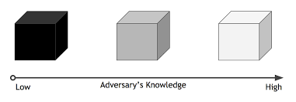
Adversarial Attacks and Defences
Based on goal of attack
  Untargeted attack : Misclassifying input to any incorrect class
  Targeted attack : Misclassifying input to a particular target class
Based on adversary knowledge
  White-box attack: Adversary has all information about the model
  Black-box attack: Adversary has no information about the model
Source: https://secml.github.io/class1/
A. Chakraborty, M. Alam, V. Dey, A. Chattopadhyay, D. Mukhopadhyay. "Adversarial attacks and defences: A
survey." arXiv preprint ArXiv:1810.00069 (2018). ACM Computing Surveys.#citations – 12, Google h5 index - 80

Slide 12
Adversarial Attacks and Defences
Defences:
Adversarial Training
  Inject adversarial samples into the training set
  Increase model robustness
Gradient Hiding
  Hiding the gradient information from adversary
  Restricting information gain by adversary
A. Chakraborty, M. Alam, V. Dey, A. Chattopadhyay, D. Mukhopadhyay. "Adversarial attacks and defences: A
survey." arXiv preprint ArXiv:1810.00069 (2018). ACM Computing Surveys.#citations – 12, Google h5 index - 80

Slide 13
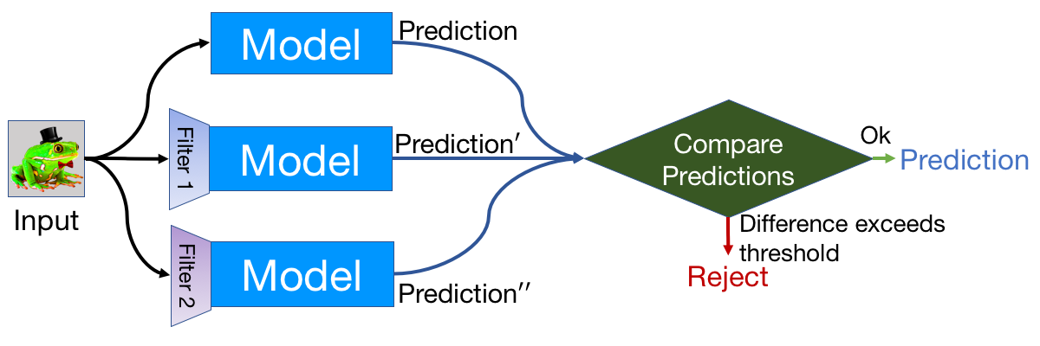
Adversarial Attacks and Defences
Feature Squeezing
  Reduce the complexity of representing data
  Adversarial perturbations disappear due to low sensitivity
  May reduce the accuracy of model
Source: https://evademl.org/squeezing/
A. Chakraborty, M. Alam, V. Dey, A. Chattopadhyay, D. Mukhopadhyay. "Adversarial attacks and defences: A
survey." arXiv preprint ArXiv:1810.00069 (2018). ACM Computing Surveys.#citations – 12, Google h5 index - 80

Slide 14
Narrowing Down to Our Work

Slide 15
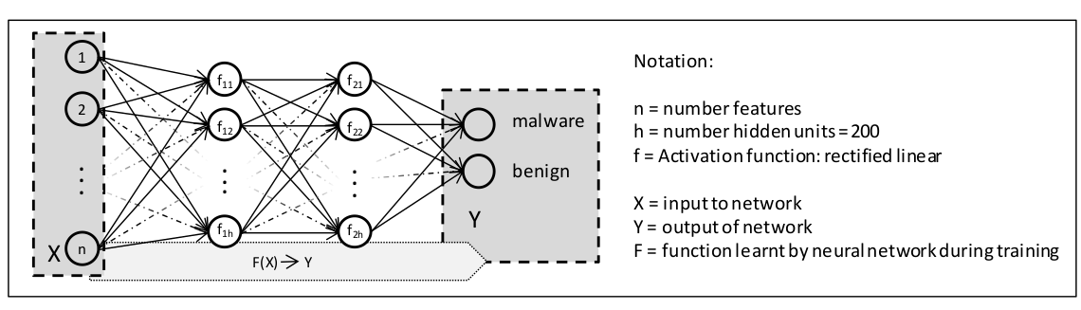
Adversarial Examples for Malware Detection
Demonstrate android malware detector that uses a neural network, deceived with adversarial examples.
Uses statically analysed features of application such as use of specific system calls, specific hardware
components.
Features represented as binary indicator vectors X; ‘0’ indicate absence of feature & ‘1’ indicates presence.
The classifier is trained using Deep Neural Network with a learned function F.
K. Grosse, N. Papernot, P. Manoharan, M. Backes, and P. Mcdanie. "Adversarial examples for malware detection."
European Symposium on Research in Computer Security. Springer, Cham, 2017.#citations – 100, Google h5 index - NA

Slide 16
Adversarial Examples for Malware Detection
To craft adversarial example:
  Find gradient of F with respect to X
  Choose a perturbation which makes the classifier to predict a target output desirable for the attacker
Target is to misclassify malware application as a legitimate one along with maintaining the functionality of malware.
Key points:
  Adversarial example crafting done through discrete value change of features( 0 to 1/ 1 to 0).
  Choose features with limited inter-dependency.
  Craft the samples in such a way that the functionality of the application is maintained.
K. Grosse, N. Papernot, P. Manoharan, M. Backes, and P. Mcdanie. "Adversarial examples for malware detection."
European Symposium on Research in Computer Security. Springer, Cham, 2017.#citations – 100, Google h5 index - NA

Slide 17
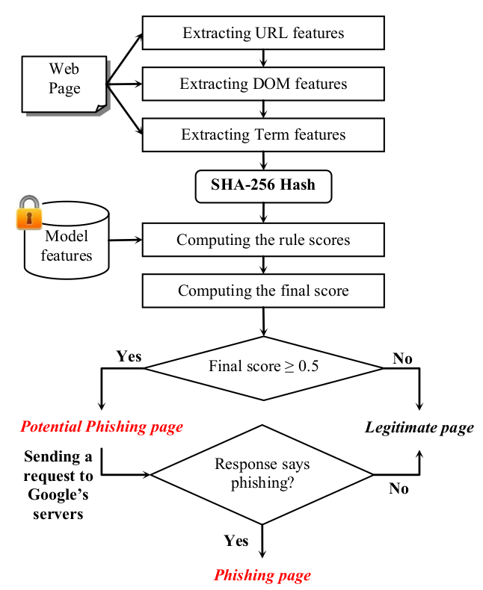
Adversarial Attack Using Reverse Engineering
Evasion attack on client side Google’s phishing pages
filter (GPFF).
Over 1 million users are vulnerable.
Client-side classifiers face serious security challenges.
Attacker can directly analyze the implementation and
configuration of classifier.
GPPF is integrated within chrome browser and is invoked
when user visits a web page.
The classifier is fooled to misclassify phishing pages as
legitimate ones.
B. Liang, M. Su, W. You, W. Shi, and G. Yang. "Cracking classifiers for evasion: a case study on the Google's phishing pages filter.
"Proceedings of the 25th International Conference on World Wide Web. International World Wide Web Conferences Steering
Committee, 2016. #citations – 17, Google h5 index - 70

Slide 18
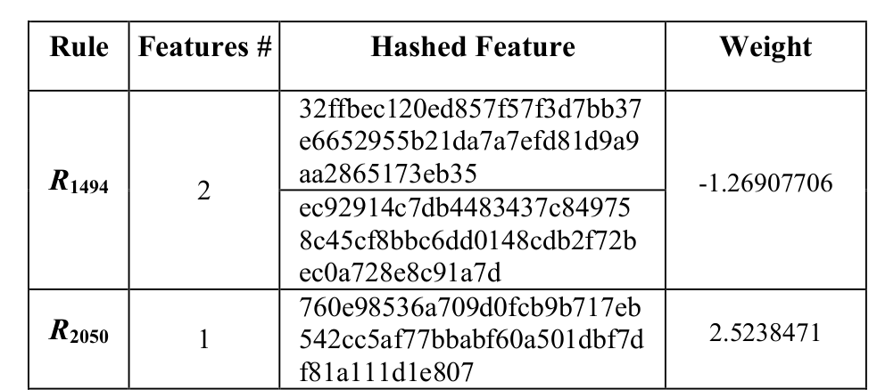
Adversarial Attack Using Reverse Engineering
Reverse engineering techniques are used to extract information from the model.
Extracted information includes classification algorithm, scoring rules and so on.
Based on extracted information attacker performs ‘good feature insertion & bad feature elimination’.
B. Liang, M. Su, W. You, W. Shi, and G. Yang. "Cracking classifiers for evasion: a case study on the Google's phishing pages filter.
"Proceedings of the 25th International Conference on World Wide Web. International World Wide Web Conferences Steering
Committee, 2016. #citations – 17, Google h5 index - 70

Slide 19
Adversarial Attack Using Reverse Engineering
Solutions
  Increase the complexity of reverse engineering the classified model.
  Convert the classifier to a closed source component of the system.
  Code obfuscation.
Drawbacks
  Deobfuscation techniques to reverse engineering obfuscated code.
B. Liang, M. Su, W. You, W. Shi, and G. Yang. "Cracking classifiers for evasion: a case study on the Google's phishing pages filter.
"Proceedings of the 25th International Conference on World Wide Web. International World Wide Web Conferences Steering
Committee, 2016. #citations – 17, Google h5 index - 70

Slide 20
Adversarial Sampling Attack Against Phishing Detection
Demonstrate the effect of adversarial sampling on phishing detection model.
Attacker
Goal
Attacker
Knowledge
Security violation
Break integrity
Error specificity Decrease True Positive Rate
Limited Knowledge
Features and their representations & Algorithms
No Knowledge Training sets and algorithm parameters
. . .
. . .
Attack specificity
Misclassify phish
H. Shirazi, B. Bezawada, I. Ray, and C. Anderson. "Adversarial Sampling Attacks Against Phishing Detection." IFIP Annual Conference on Data and Applications Security and Privacy. Springer, Cham, 2019. #citations – 0,Google h5 index - NA

Slide 21
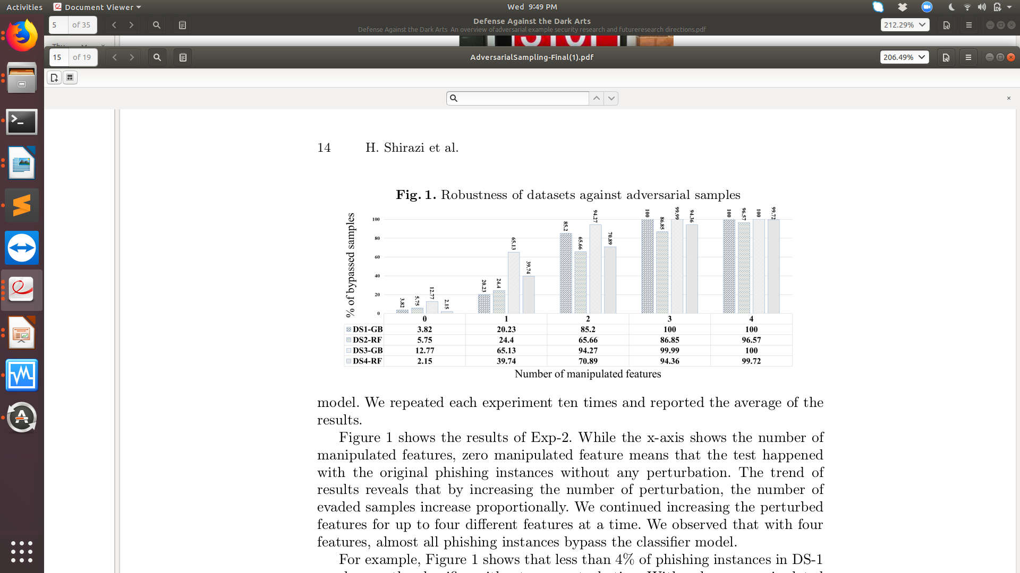
Adversarial Sampling Attack Against Phishing Detection
Dataset consist of ‘d’ features for each instance and corresponding label.
‘0’ indicates a legitimate page and ‘1’ indicates phishing page.
Different combinations of features are considered [ 0 - feature selected, 1 - feature not selected].
Original phishing instance and selected features used to create adversarial sample.
H. Shirazi, B. Bezawada, I. Ray, and C. Anderson. "Adversarial Sampling Attacks Against Phishing Detection." IFIP Annual Conference on Data and Applications Security and Privacy. Springer, Cham, 2019. #citations – 0,Google h5 index - NA

Slide 22
Adversarial Sampling Attack Against Phishing Detection
Adversary should craft the sample with two things in mind:
  Visual appearance of website
  Functionality of website
Drawback:
  Manipulation of features without reconstruction of phishing page
Challenges:
  Difficulty in understanding the exact methodology proposed by the authors
H. Shirazi, B. Bezawada, I. Ray, and C. Anderson. "Adversarial Sampling Attacks Against Phishing Detection." IFIP Annual Conference on Data and Applications Security and Privacy. Springer, Cham, 2019. #citations – 0,Google h5 index - NA

Slide 23
Proposed Architecture
To craft an adversarial sample and attack a phishing detection model.
To test a defence mechanism against the adversarial attack on phishing detection model.

Slide 24
Roadmap Until Next Review
Build a phishing detection model.
Craft adversarial samples along with maintaining the functionality of the phishing page.

Slide 25
Conclusion
Adversarial attacks represent a concrete problem in the field of machine learning.
The vulnerability of phishing detection models to adversarial attacks could lead to exposure of sensitive information of millions of users.
There is a need for robust defence mechanisms against adversarial attacks on phishing detection models.

Slide 26
References
[1] K. Grosse, N. Papernot, P. Manoharan, M. Backes, and P. Mcdaniel, “Adversarial Examples for Malware Detection”,
Computer Security – ESORICS 2017 Lecture Notes in Computer Science, pp. 62–79, 2017.
[2] I. Goodfellow, “Defense Against the Dark Arts: An overview of adversarial example security research and
future research directions,” arXiv.org, 11-Jun-2018. [Online]. Available: https://arxiv.org/abs/1806.04169.
[Accessed: 13-Sep-2019].
[3] A. Chakraborty, M. Alam, V. Dey, A. Chattopadhyay, D. Mukhopadhyay, “Adversarial Attacks and Defences: A Survey,”
arXiv.org, 28-Sep-2018. [Online]. Available: https://arxiv.org/abs/1810.00069. [Accessed: 13-Sep-2019].
[4] B. Liang, M. Su, W. You, W. Shi, and G. Yang, “Cracking Classifiers for Evasion: a case study on the google's
phishing pages filter,” Proceedings of the 25th International Conference on World Wide Web - WWW 16, 2016.
[5] H. Shirazi, B. Bezawada, I. Ray, and C. Anderson, “Adversarial Sampling Attacks Against Phishing Detection,”
Data and Applications Security and Privacy XXXIII Lecture Notes in Computer Science, pp. 83–101, 2019.
[6] I. Goodfellow, J. Shlens, and C. Szegedy, “Explaining and Harnessing Adversarial Examples,” Google AI, 01-Jan-1970. [Online]. Available: https://ai.google/research/pubs/pub43405. [Accessed: 21-Sep-2019].

Slide 27
Thank You

